Slide 1
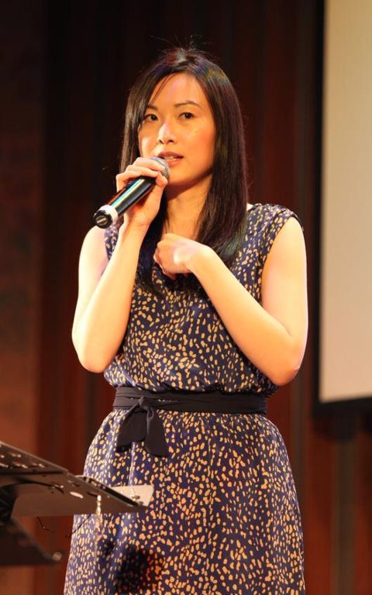
Nang Chawngkung changna kha itiah rei rang a monih
Dr. Rick Griffith, Singapore Bible College
BibleStudyDownloads.org

Slide 2


Chawngreina a ratna
vii
Omolongna (1 min.)
Chawngkungchangna risim (2-3 min.)
Takahmoson narang irei (2 min.)
Mejekchawng achawi (15 min.)
Richijar a asok chongrokhom (15 min.)
Notes:
Same slide for presentation 01.54 and 02.07 so translators may copy from one to the other

Slide 3
Nang chawngkungchang na kah eloi a rei rang a monih?
16
Arei rang a nang rang avaidet
Nang nininga nang rejet det
Patheenchawng reinalam inih
Dr Rick Griffith, Singapore Bible College
www.biblestudydownloads.com
Notes:
Same slide for presentation 01.49 and 02.03 so translators may copy from one to the other except that 02.03 expands the 01.49 slide

Slide 4
16
Nang chawngkungchang na kah eloi a rei rang a monih?
Arei rang a nang rang avaidet
Nang nininga nang rejet det
Chance to share what you have learned
Nang rishim kha mihai na arangai jot
Patheen nang jet det rang nih
Helps you see what God has done
Patheenchawng reina lam inih
Mihai le nang rechepthei det rang nih
Mihai na tik te nit a awm narakha thei nonih
Notes:
Same slide for presentation 01.49 and 02.03 so translators may copy from one to the other except that 02.03 expands the 01.49 slide

Slide 5
Chawngkungchangna reidan
16
Athar a shokshule:
Nik imining
Erelekna
Riding masak roh!
Athar a shokna:
Ashokha reiroh
Imo nang rangampui
Riding masak roh!
Nikreina lawn kha riding pip a tet roh!
Athar a shok mala:
Nik imining
Niktho
Riding masak roh!
Notes:
Same slide for presentation 01.50 and 02.04 so translators may copy from one to the other

Slide 6
Ko Chawngkungchangana
19
Athar a shokshule:
Arachak
Rangamnapui
Miringhai numpokna
Athar a Shokna:
Nungak-Rothar ruchunna
Jesu, Patheen khutchawi nitna
“Olona kabangjoi”
Nikreina Rangamnapui lawn kha riding pip a
tet roh!
Athar a shok mala:
Atha Chawn
“Rangamrepna”
Rangamnapui awmboi

Slide 7
Black

Slide 8


Chawngrophongna (Retheina) hin awm BibleStudyDownloads.org
Mahi rachakna hi arem ah mukthei inih!
Notes:
Preaching (pr)
Homiletics

